Slide 1
VLAN Theory and Implementation
Gilbert Detillieux, Computer Science
Presented to MUUG, October 2017

Slide 2

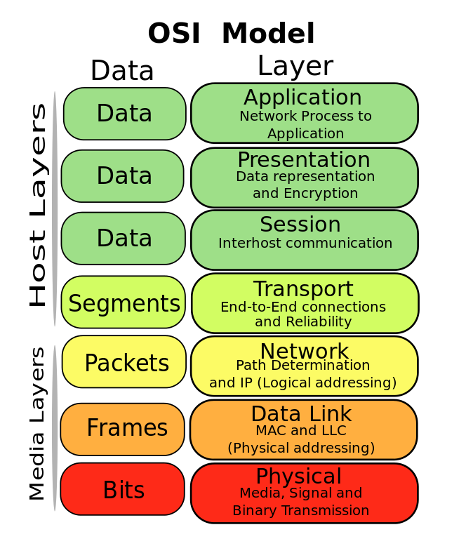
7-Layer Model
7
6
5
4 (TCP, UDP)
3 (IP, Routers)
2 (Ethernet, Switches, Bridges)
1 (100BaseT, Hubs, Repeaters)
Source: https://commons.wikimedia.org/wiki/File:Osi-model-jb.svg
licensed under the Creative Commons Attribution-Share Alike 3.0 Unported license

Slide 3
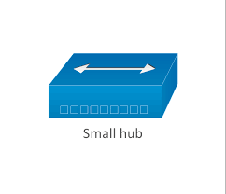



Routers, Switches, and Hubs, Oh My!
Device: | Hub | Bridge | Switch | Router
OSI Layer | 1 | 2 | 2 | 3
Collision Domains | 1 | 2 | 1/port | 1/port
Broadcast Domains | 1 | 1 | 1 | 1/port

Slide 4
What is a VLAN?
A virtual LAN (VLAN) is any broadcast domain that is partitioned and isolated in a computer network at the data link layer (OSI layer 2) … creating the appearance and functionality of network traffic that is physically on a single network but acts as if it is split between separate networks.
In this way, VLANs can keep network applications separate despite being connected to the same physical network, and without requiring multiple sets of cabling and networking devices to be deployed.
Source: https://en.wikipedia.org/wiki/Virtual_LAN
licensed under the Creative Commons Attribution-ShareAlike License

Slide 5
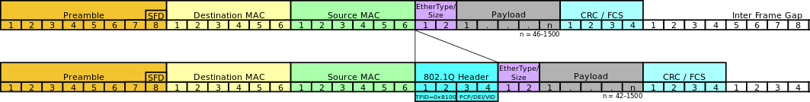
VLAN Tagging (IEEE 802.1Q)
adds a 32-bit field between the source MAC address and the EtherType fields
Tag protocol identifier (TPID): a 16-bit field set to a value of 0x8100
Priority code point (PCP): a 3-bit field which refers to the IEEE 802.1p class of service
Drop eligible indicator (DEI): a 1-bit field (congestion management)
VLAN identifier (VID): a 12-bit field
  0x000 and 0xFFF are reserved
  other values may be used as VLAN identifiers, allowing up to 4,094 VLANs
Source: https://en.wikipedia.org/wiki/IEEE_802.1Q
licensed under the Creative Commons Attribution-ShareAlike License

Slide 6
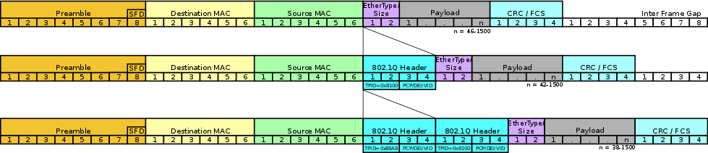
Double Tagging (802.1ad)
useful for Internet service providers
allow use of VLANs internally while mixing traffic from clients that are already VLAN-tagged
outer (representing ISP VLAN) S-TAG (service tag) comes first
inner C-TAG (customer tag) next
TPID of 0x88a8 for service-provider outer S-TAG
Source: https://en.wikipedia.org/wiki/IEEE_802.1Q
licensed under the Creative Commons Attribution-ShareAlike License

Slide 7
IOS Access Mode vs Trunk Mode
! Port 1 in access mode:
interface GigabitEthernet1/0/1
switchport access vlan 10
switchport mode access
! Port 24 (uplink) in trunk mode:
interface GigabitEthernet1/0/24
switchport trunk encapsulation dot1q
switchport mode trunk
Sample Cisco IOS Configuration

Slide 8
Trunk Mode with VLAN Filtering
! Define our VLAN’s:
vlan 10,20,30
…
! Restricted Trunk Port:
interface GigabitEthernet1/0/24
switchport trunk encapsulation dot1q
switchport trunk allowed vlan 10,20
switchport mode trunk
Sample Cisco IOS Configuration

Slide 9
Trunk Mode with Native VLAN
! Define our VLAN’s:
vlan 10,20,30
…
! Transitional Trunk Port:
interface GigabitEthernet1/0/24
switchport trunk encapsulation dot1q
switchport trunk native vlan 10
switchport mode trunk
Sample Cisco IOS Configuration

Slide 10
VLAN Support – Linux
Similar mechanism to virtual interfaces (e.g. eth0:1)
Parent interface (e.g. eth0) will send/receive untagged frames on native VLAN
Define a separate child interface (e.g. eth0.10) per VLAN
These interfaces will send/receive tagged frames for those specific VLANs
Tagging done at kernel level; no direct user-level manipulation

Slide 11
VLAN Setup – Linux Commands
vconfig add eth0 10
… or …
ip link add link eth0 name eth0.10 type vlan id 10
… or …
nmcli con add type vlan ifname VLAN10 dev eth0 id 10
Sample Linux Commands for VLAN Configuration

Slide 12
VLAN Setup – Red Hat ifcfg File
# /etc/sysconfig/network-scripts/ifcfg-eth0.10
DEVICE=eth0.10
VLAN=yes
BOOTPROTO=none
ONBOOT=yes
IPADDR=192.168.1.1
PREFIX=24
NETWORK=192.168.1.0
…
Sample Red Hat Linux ifcfg Script for VLAN Configuration

Slide 13
VLAN Setup – Debian interfaces
# /etc/network/interfaces
auto eth0.10
iface eth0.10 inet static
address 10.10.10.1
netmask 255.255.255.0
vlan-raw-device eth0
…
Sample Debian / Ubuntu Linux interfaces File for VLAN Configuration

Slide 14
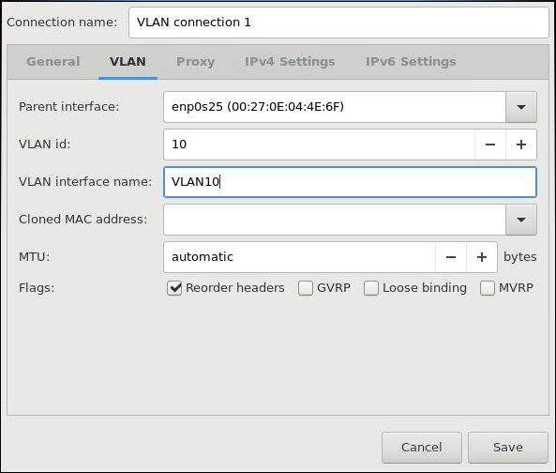
VLAN Setup – Linux / Gnome3
open the Network window, click the plus symbol, and select VLAN from the list
select the parent interface from the drop-down list
enter the VLAN ID
enter a VLAN interface name
Save…
Sample Gnome NetworkManager Dialogue for VLAN Configuration

Slide 15
Further Reading
https://www.thomas-krenn.com/en/wiki/VLAN_Basics
https://en.wikipedia.org/wiki/IEEE_802.1Q
https://en.wikipedia.org/wiki/Multiple_Registration_Protocol
https://www.cisco.com/c/en/us/tech/lan-switching/virtual-lans-vlan-trunking-protocol-vlans-vtp/tech-configuration-examples-list.html
https://www.cyberciti.biz/tips/howto-configure-linux-virtual-local-area-network-vlan.html
https://access.redhat.com/documentation/en-us/red_hat_enterprise_linux/7/html/networking_guide/ch-configure_802_1q_vlan_tagging
https://wiki.debian.org/NetworkConfiguration#Howto_use_vlan_.28dot1q.2C_802.1q.2C_trunk.29_.28Etch.2C_Lenny.29

Slide 16


This work is available under the Creative Commons
Attribution-NonCommercial-ShareAlike 2.5 Canada (CC BY-NC-SA 2.5 CA) license

